Slide 1
Industrial training
By:
Shivani dalmia
06314802717
7c4

Slide 2
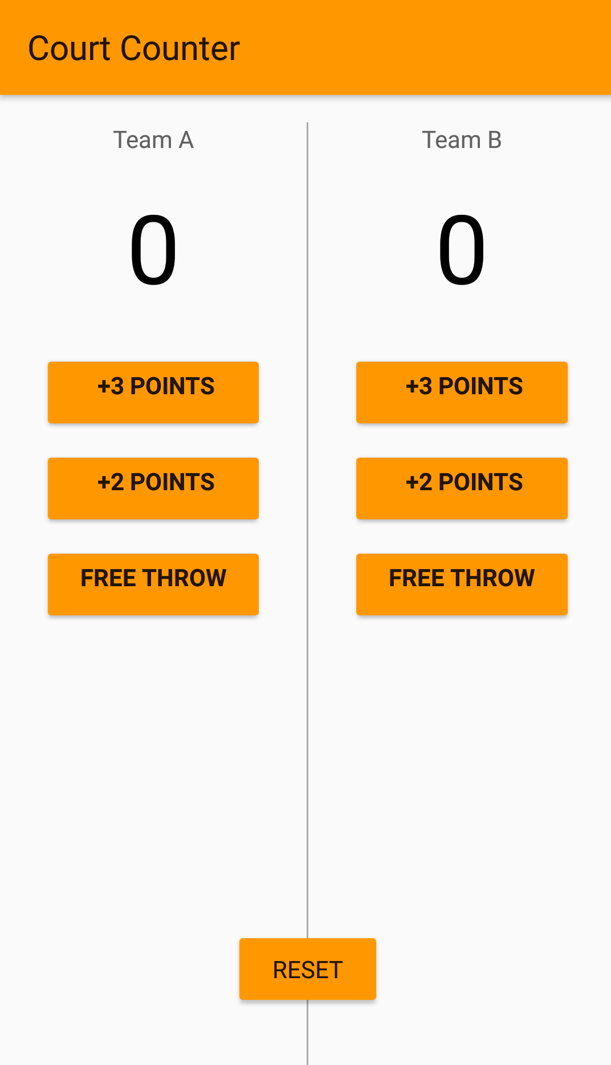
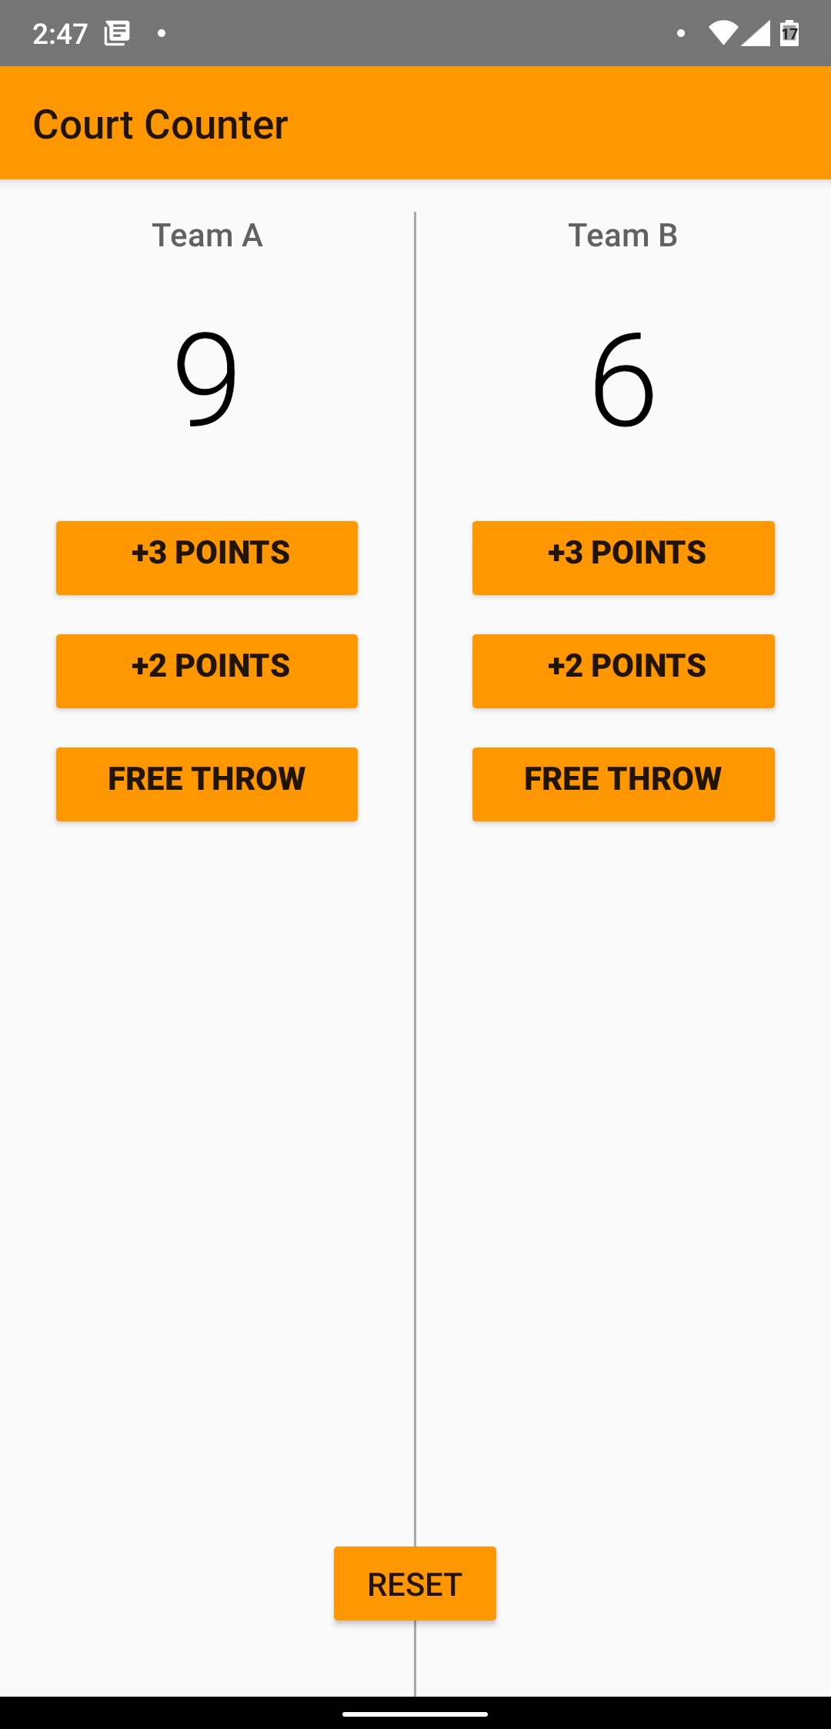
Court Counter
A classic counting app to keep check of scores in an intense Basketball match

Slide 3
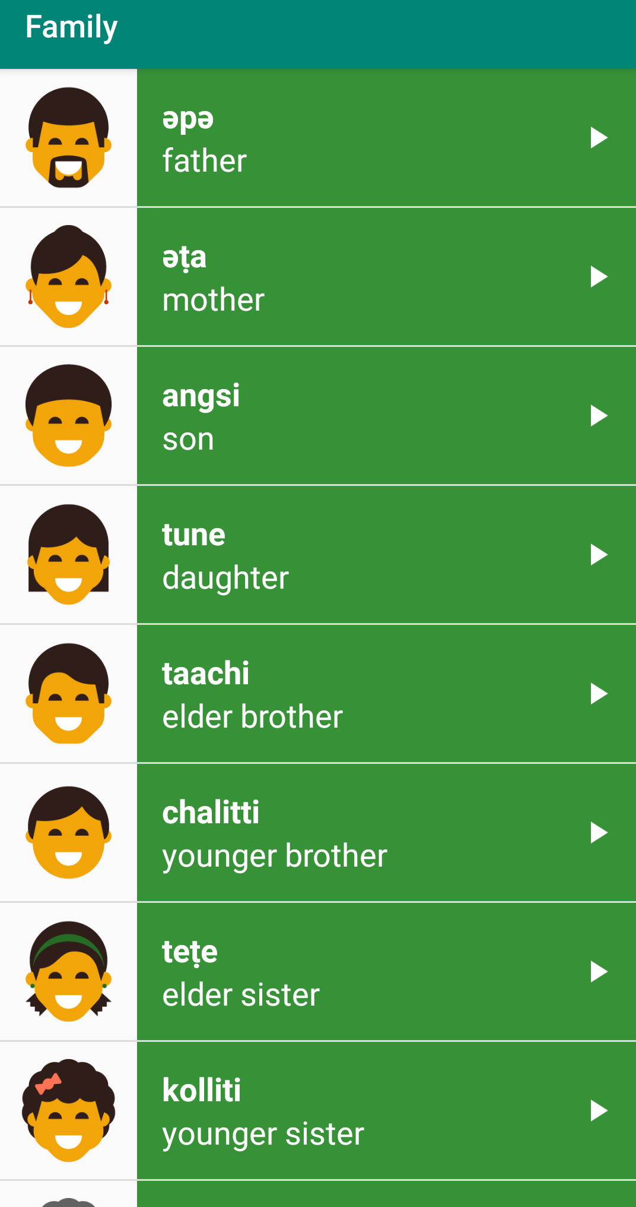
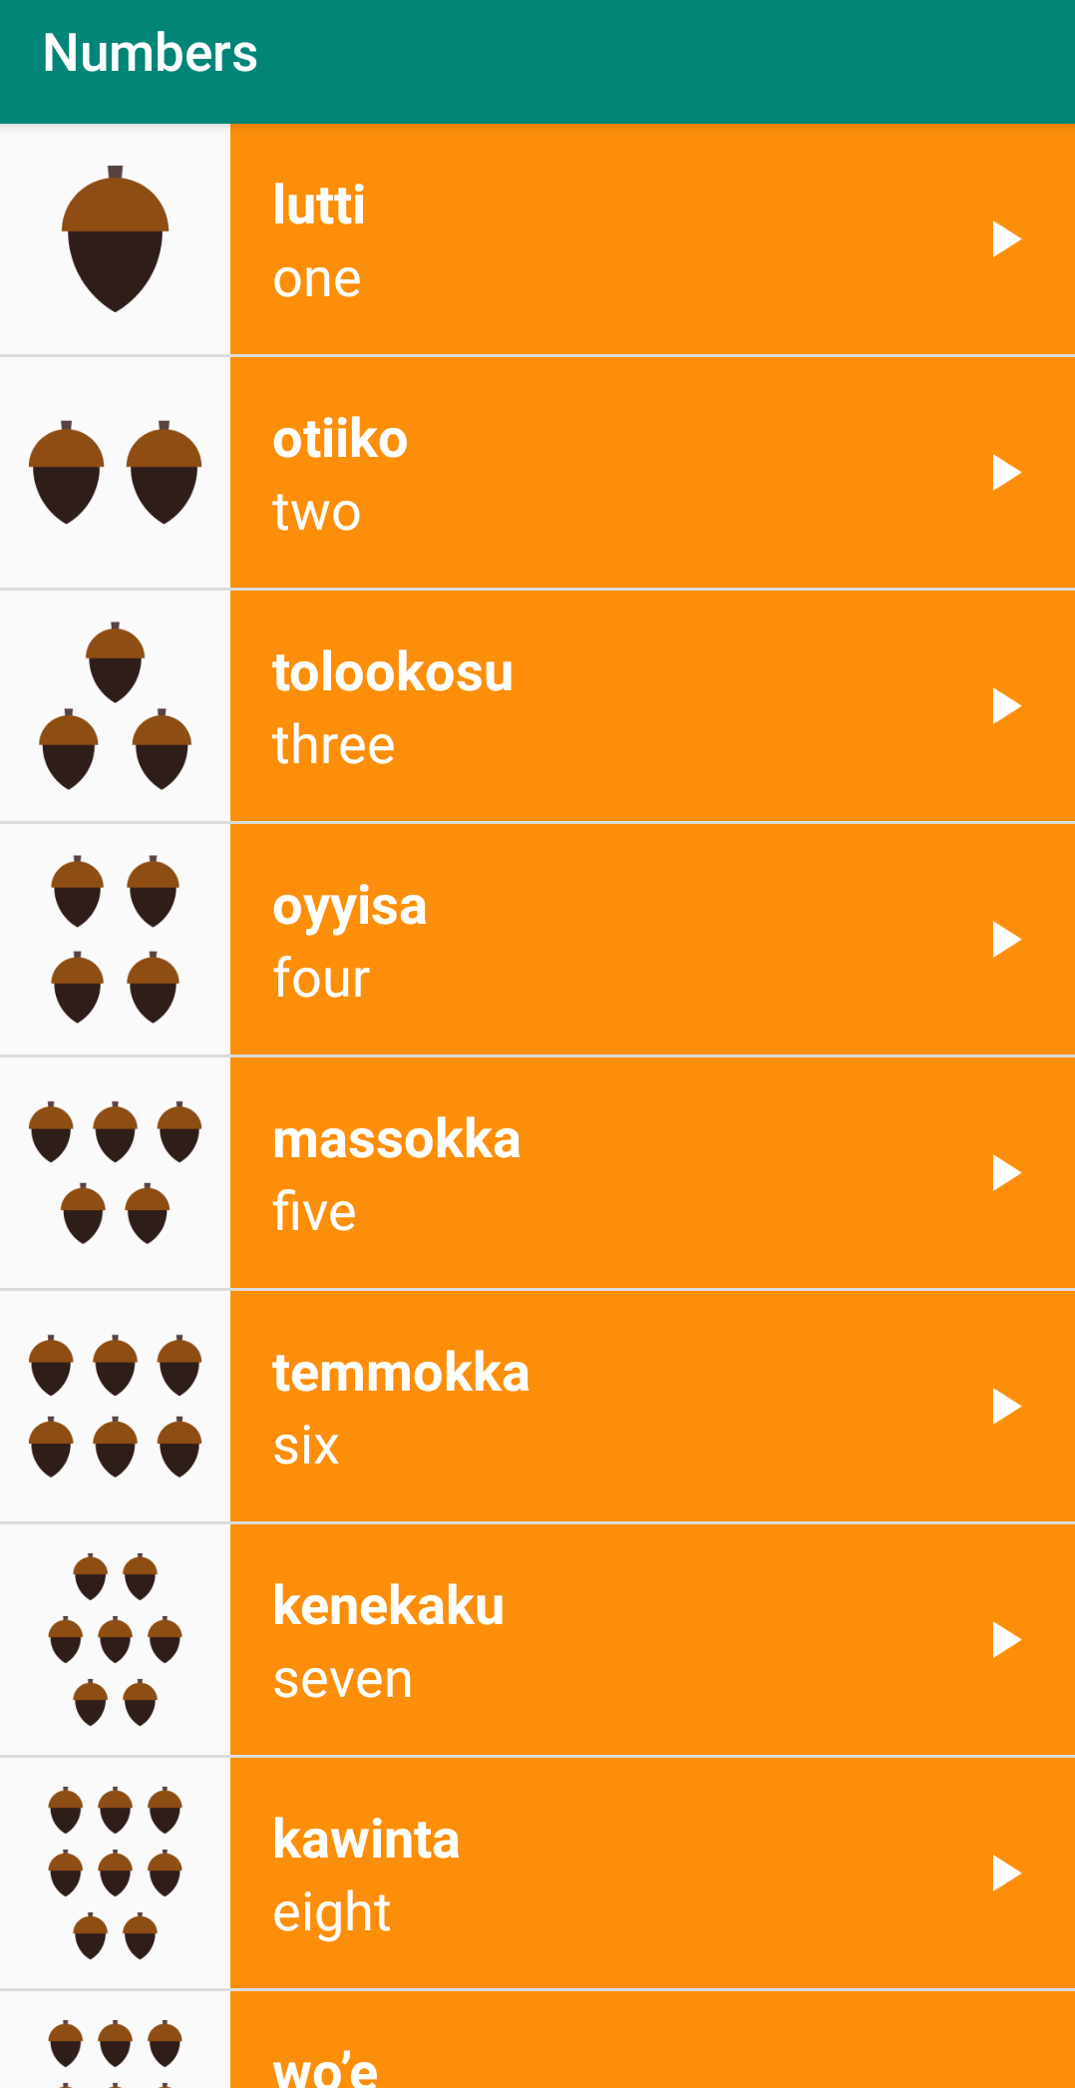
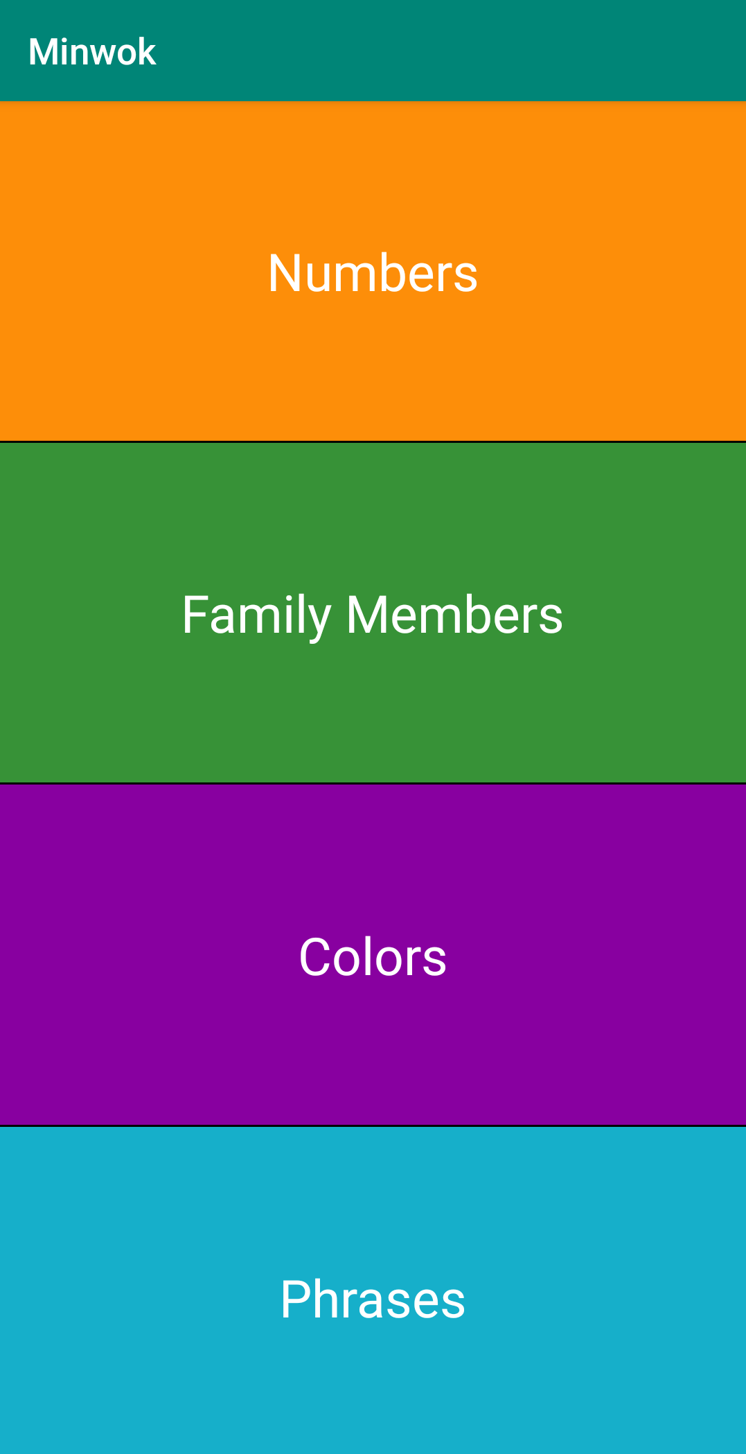
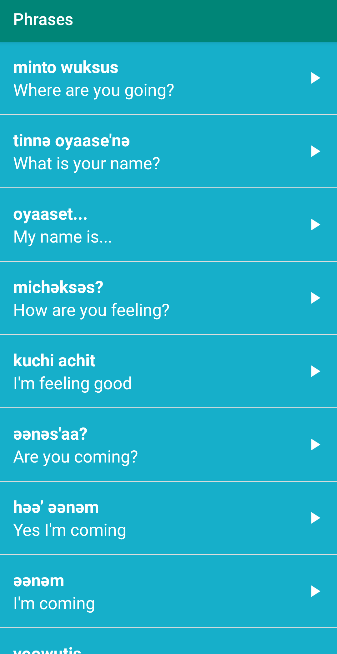
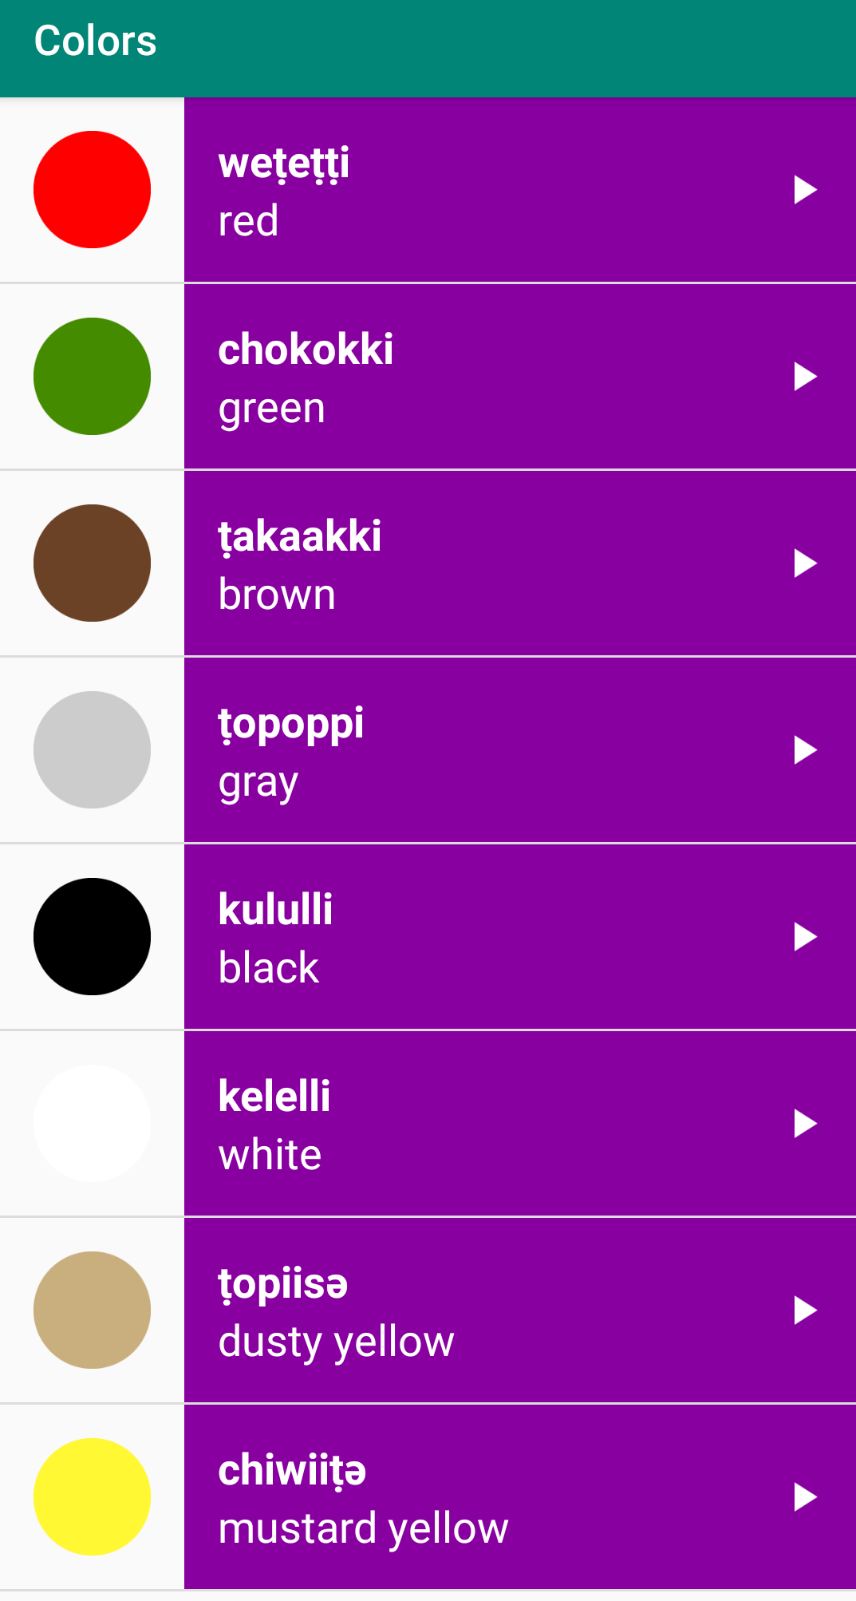
Minwok
It is a voice assisted Minwok language learning app designed for better and easy grasping of words and numbers along with pronunciation.

Slide 4
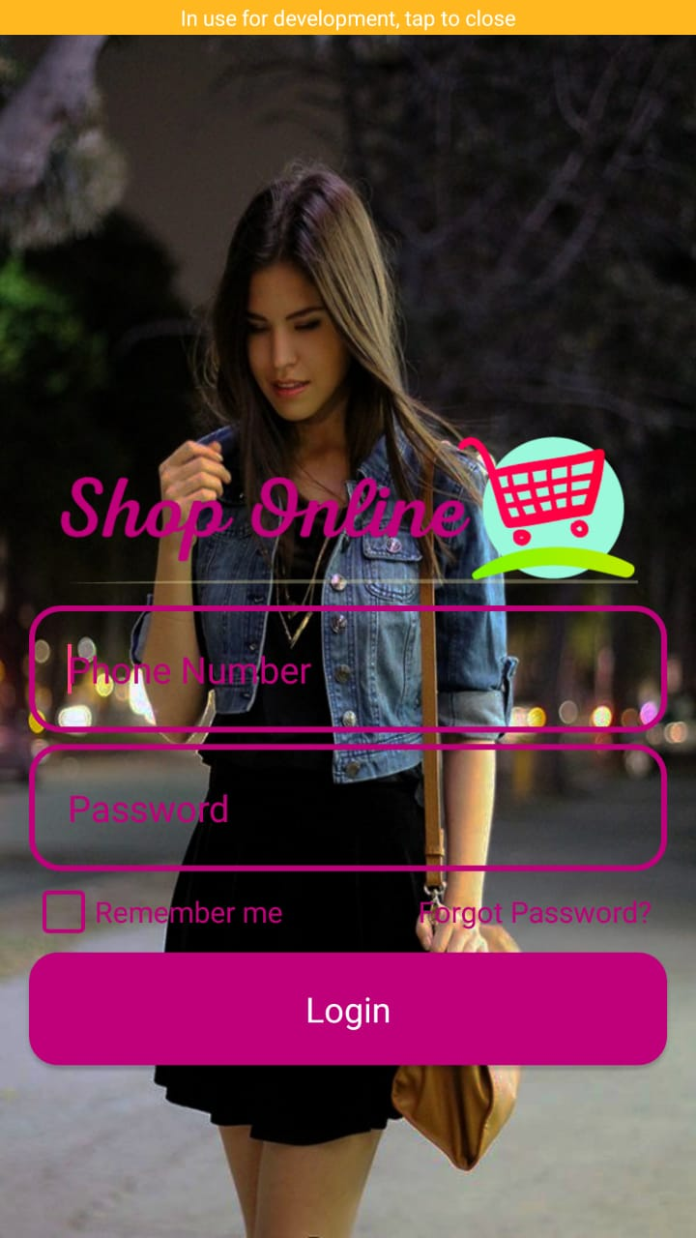


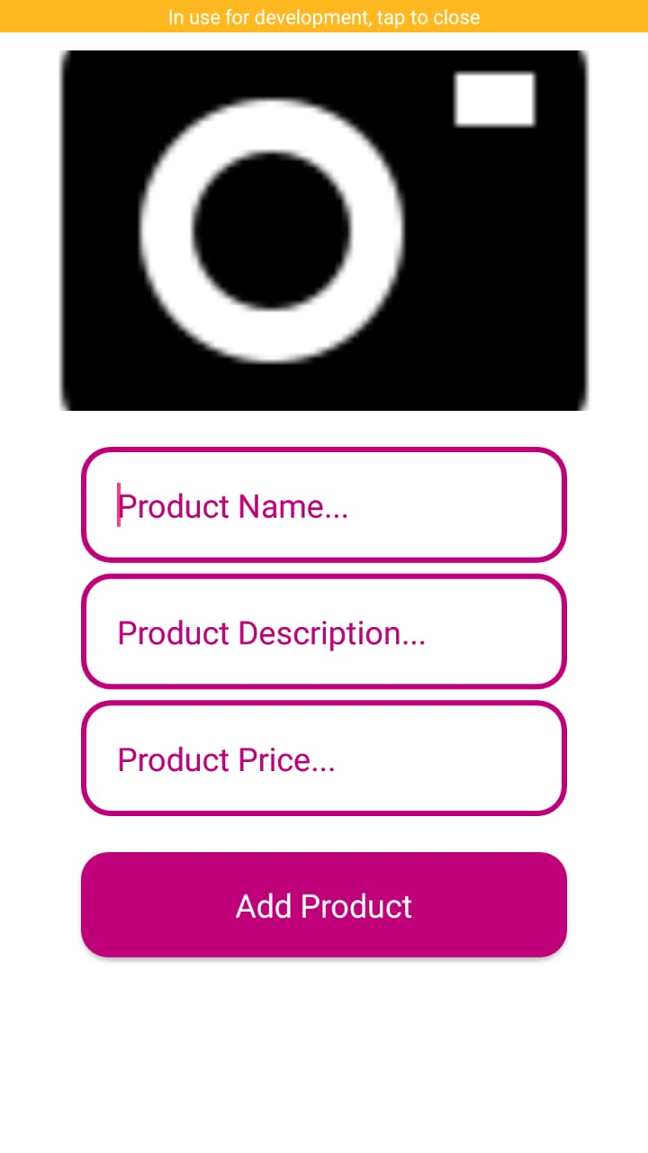

shopify
An ongoing project for a startup aimed to sell vogue garments and accessories

Slide 5
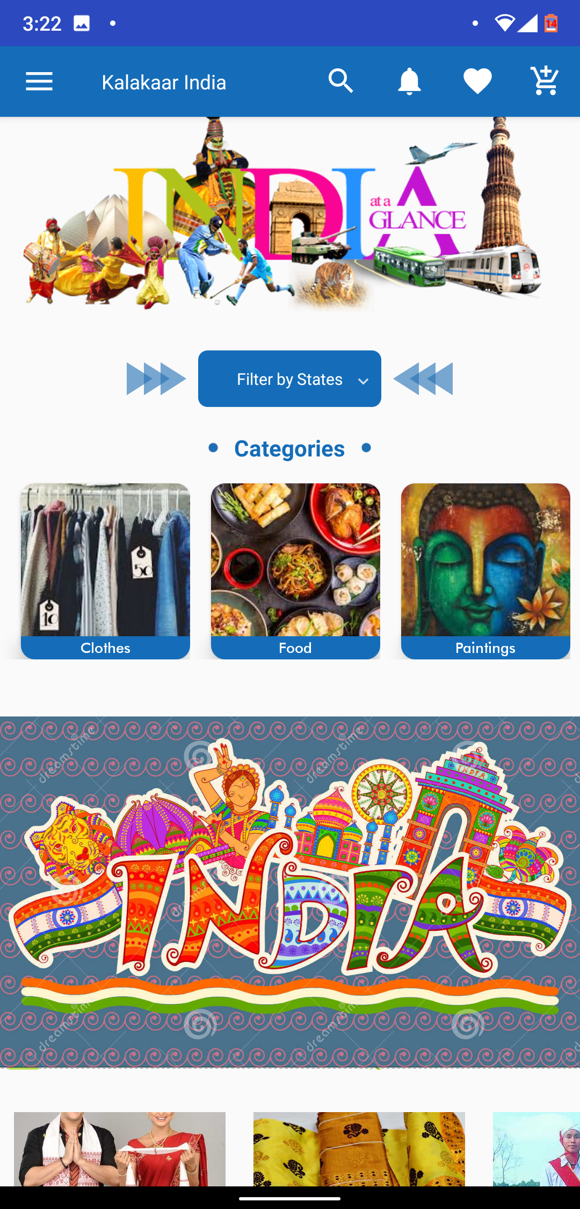
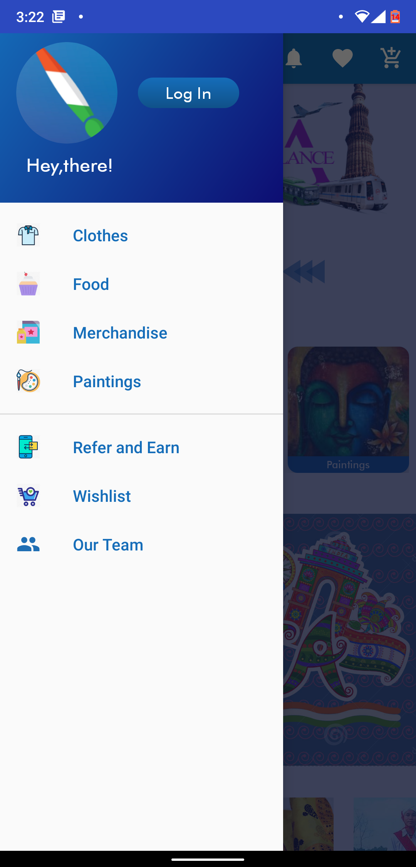
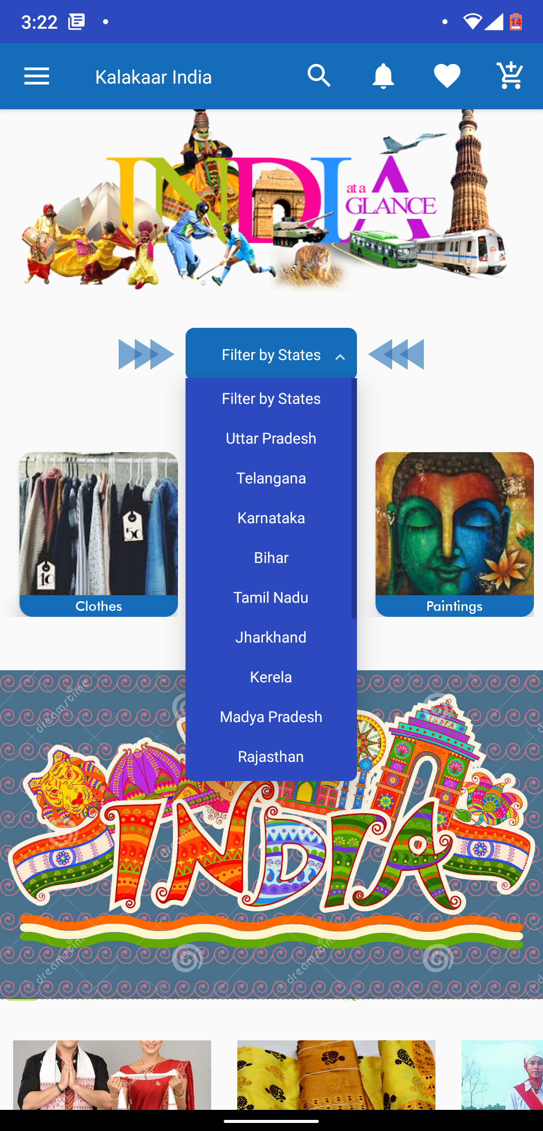
Kalakaar india
An internship project where I played major role in UI development.
ccc

Slide 6
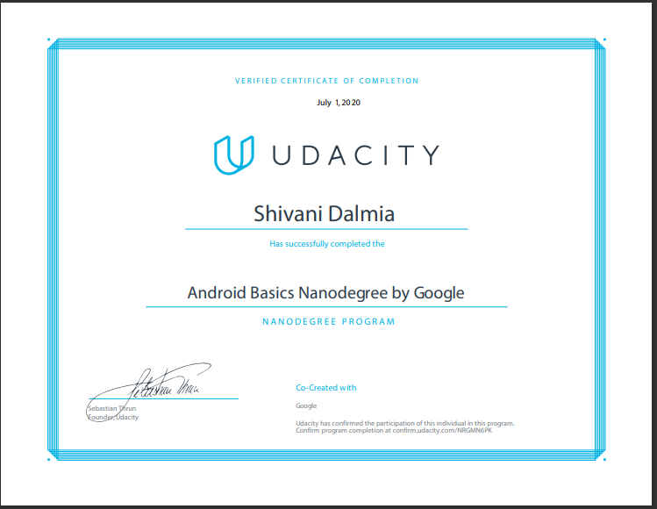
certificate

Slide 7
Thank you

